Slide 1

HIS103.04
Group
-2
How British
Looted India
And
Bengal
Khadiza islam ID-1711980630 Nabil Shadman ID- 1731115042
Towhidul Alam ID- 1821732042
Abhishek Das ID-1922157642 Abdul Kader Shaon ID- 1911702643
Nusrat Jahan ID- 1911657042
One of the
Greatest Loot
In History

Slide 2

Introduction
Why Did British come to
India?
Pre History of Britain
What happened between 1765 to 1940

Slide 3
Impact of British Colonial Rule on India’s Economy
Britain’s GDP was more or less than 2 percent in world GDP back to 1609
In 1947,the GDP increase by 4% of world GDP
During 1870-1900, 900 million pounds has been transferred from India to Britain
Benefits from the source of market and
Raw materials
But,Biggest importer of British goods used to come from India
So,The total loot of "45 Trillion US Dollars!

Slide 4
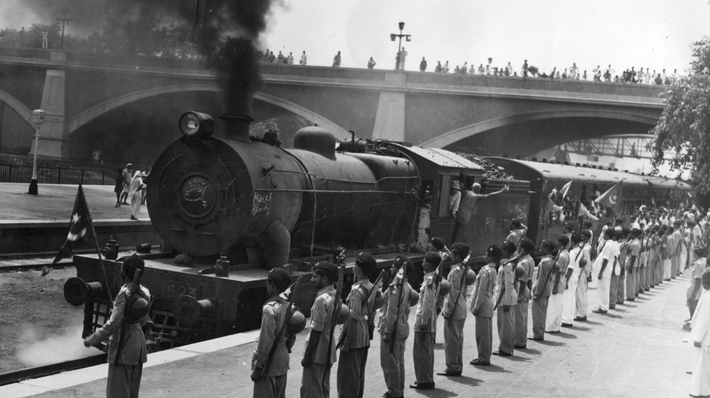
Real Reasons of Making Railways in India
Financial Benefits
Major Employment
Of Only British people
Economical Profits

Slide 5

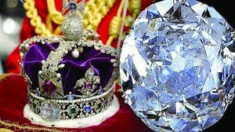

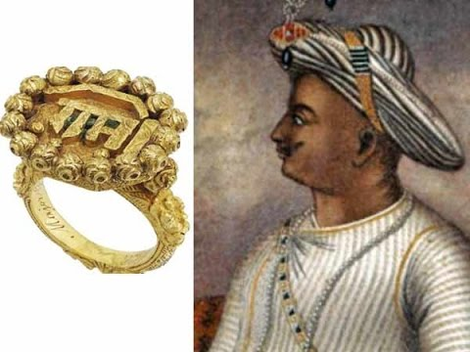
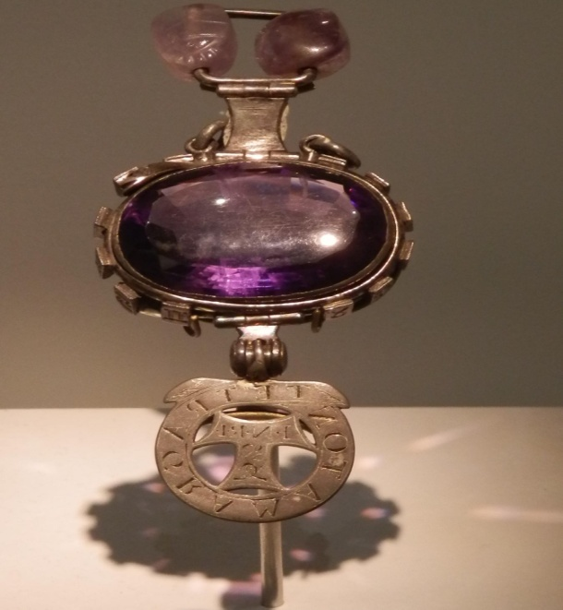

Historical Things of India Looted by British
Koh-I-Noor
Nassak Diamond
Ring of
“Tipu Sultan”
Delhi Purple
Sapphire
The Agra Diamond
Neither of these things were gifted.They were stolen by “Britain”

Slide 6
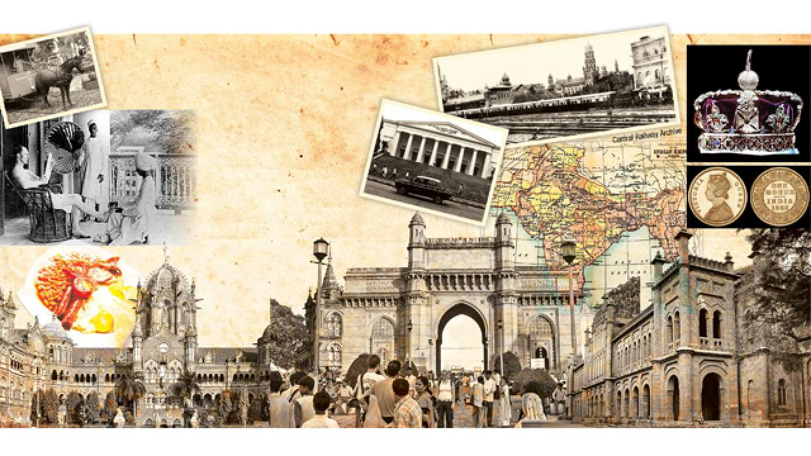
Losses in Various Sectors
Economic Loss
Trade Loss.
Cultural Loss
Education Loss
Religious Loss
They replaced everything as a joke

Slide 7
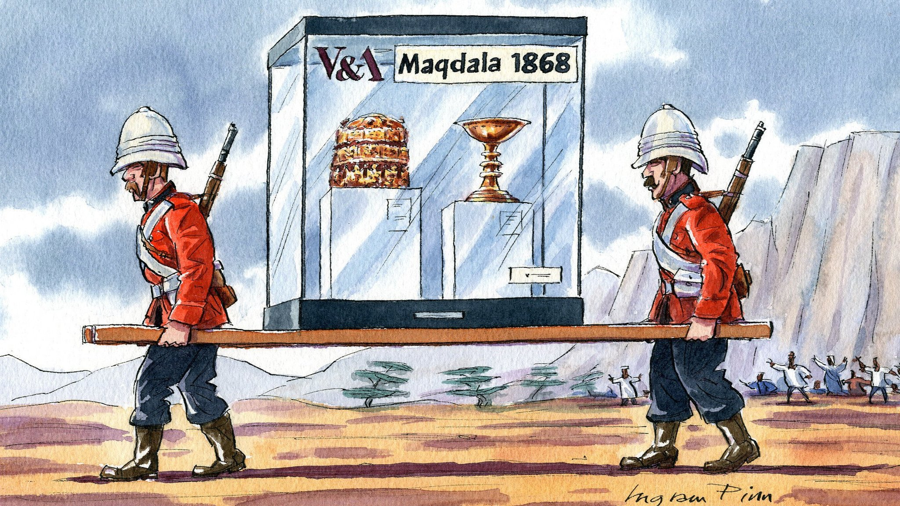
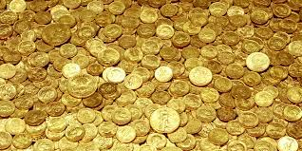
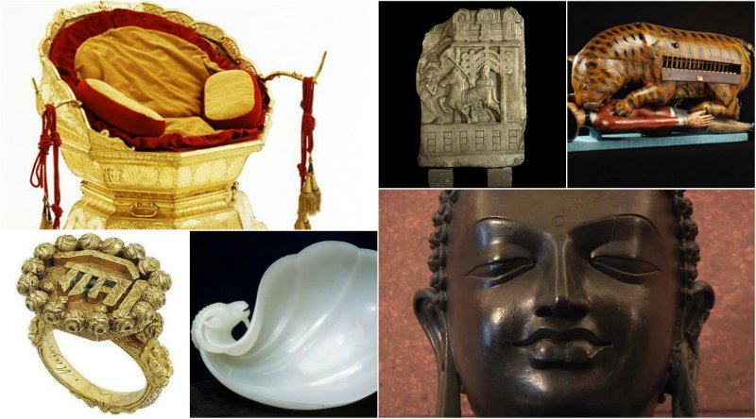
Indian society became very much driven by the manipulation of British
Massive economy structure changes
British tripled their profits
Conclusion
Monopoly on the Indian trade

Slide 8

Thank You

